Slide 1





How To Win in the NBA
Team
Aaron Chen
Alejandro Montesinos
Christian De Vera
Zane Brown

Slide 2

Introduction
Imagine yourself as an analytics consultant for an NBA Team. Your GM wants to WIN the championship (obviously).
Which factors contribute to winning? What doesn’t matter?
Is offense more important? Or defense?
What recommendations would you make? Why?

Slide 3
` ¿Questions?
(Zane) Do teams that focus on long range shooting do better? Do the “quantity”of 3 point shots matter or just the “quality” (efficiency)?
(Christian) Does mid-range shooting make a difference to a team’s success (or lack thereof)?
(Aaron) Old skool teams used to focus on defense. After all “defense wins championships”. Or does it?
(Alejandro) Which offensive and defensive factors contribute to winning? How important is each?

Slide 4
How We Got Our Data
Focused on the last 5 seasons (410 games)
“Basketball Reference” provides annual team by team statistics in 100 categories. (macro)
“NBA.com” breaks down every shot taken classified by distance from the hoop. (micro)

Slide 5
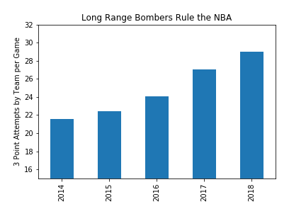
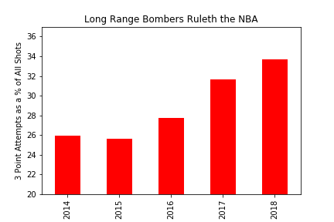
Long Range Bombers

Slide 6
Shooting From Distance
The old ABA (1967-1976) awarded 3 points for shots made at least 23 feet 9 inches from the hoop.
It took 8 years for any one team to average even one 3-pointer converted over the course of a season.
In 1994-95 teams made 36% of their “bombs”, the same as now.
This season the Houston Rockets are attempting more 3-pointers than 2 pointers. Daryl Morey, their GM, is a strong proponent of analytical methods.

Slide 7
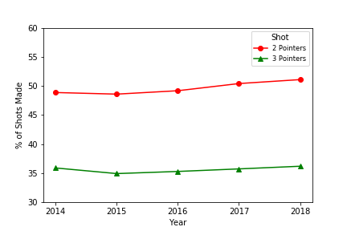

2 point shot vs 3 point shot

Slide 8
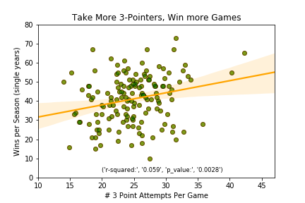
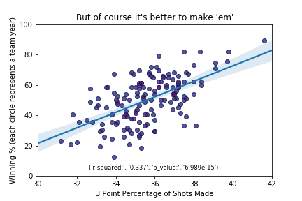
A Make or Miss League...

Slide 9
Modern Day NBA Offenses: More 3s, Less Mid Range Shots
This new approach to offense where teams shoot more 3s, avoid mid range shots, and rely on analytics has been dubbed as “Moreyball”, named after the Houston Rockets general manager Daryl Morey.
The idea is that the mid range shot is the least efficient shot in basketball.
This is because mid range shots are difficult to make as they’re far away from the basket (10-22 ft.), but they don’t have the added bonus of one extra point like a 3-pointer.

Slide 10
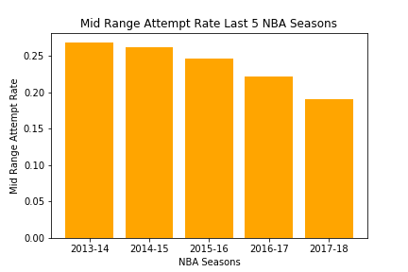
Mid Range Attempt Rate is Trending Downward...

Slide 11
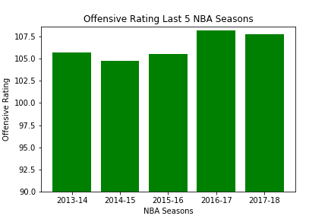
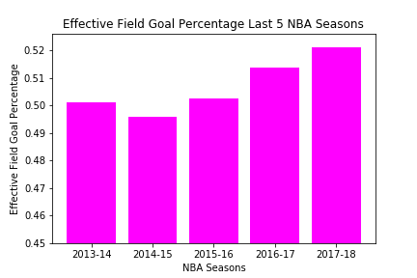
...While Offensive Efficiency is Trending Upward

Slide 12
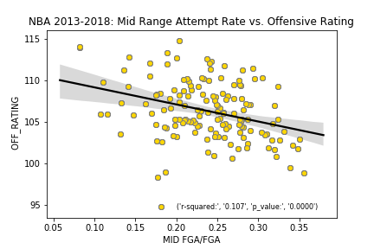
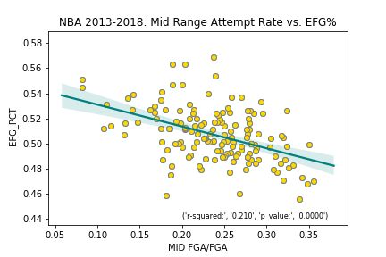
Mid Range Attempt Rate - Effect on Offensive Efficiency

Slide 13
Does Defense Win Games?
Coaches always say “Defense wins championships”
Historically elite defensive teams achieve more success
We wanted to find out if defenses are still important in today's NBA where more teams are shooting 3 pointers and focusing on offensive sets
Let’s compare defensive ratings & stats with wins and examine if teams are playing better defense dating back to the 2013-14 season

Slide 14
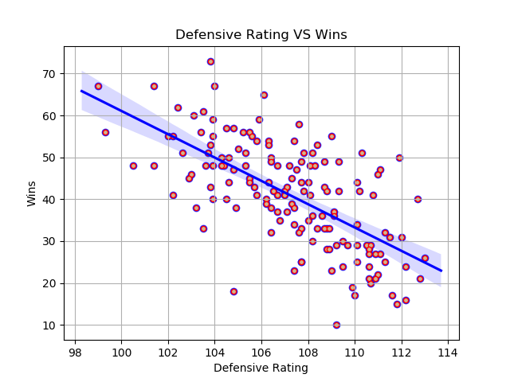
Defensive Rating VS Wins
Defensive rating = how many points a team allows per possession
Strong negative correlation
Findings: Teams with higher defensive ratings win more games

Slide 15
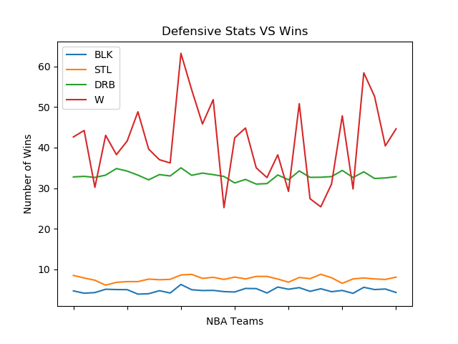
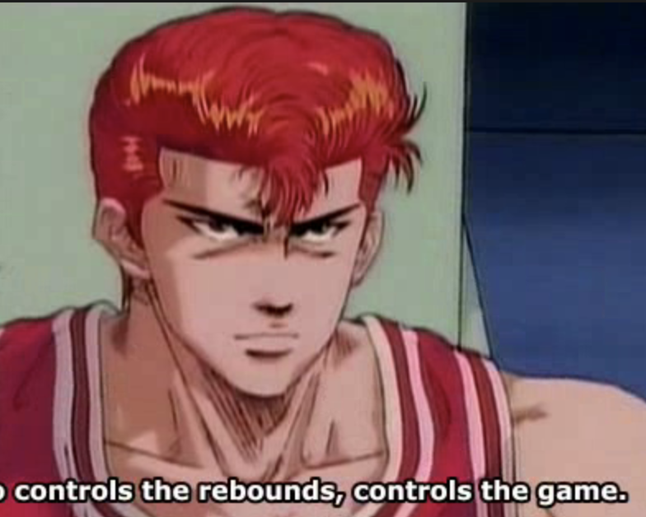
Defensive Stats VS Wins
Findings: No correlation between defensive stats and winning

Slide 16
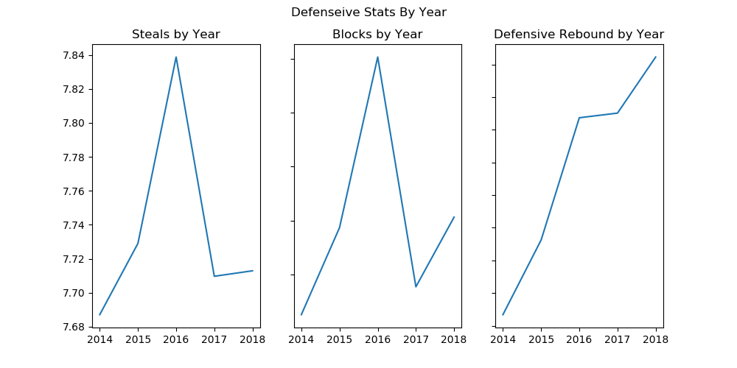
Defensive Stats by Year
Strong correlation between blocks and steals
Huge spike in defensive stats in 2015-16 season
Defensive rebounding is trending up due to faster pace and emphasis on defending “the fast break”

Slide 17
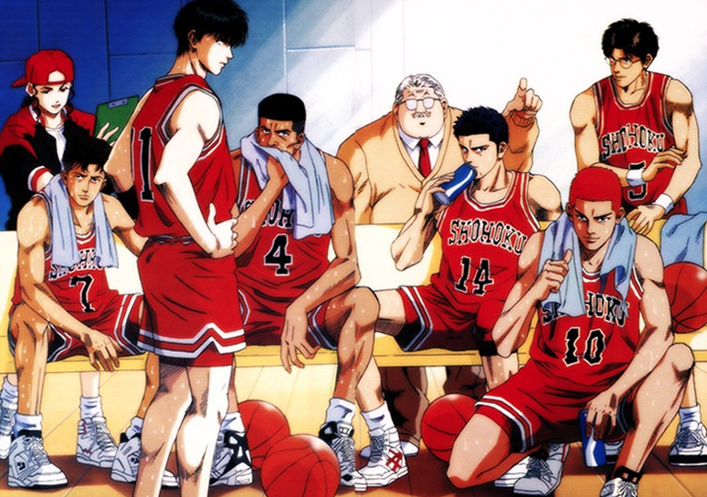
Team Performance Influence on Winning
Inspired by Hollinger's Player Efficiency Rating (PER)
Combines several aspects of the game in one measure by aggregating positive factors (like RB & A) and subtracting out negative ones (like TO).
The challenge is to come up with a measure similar to PER that captures the level of team performance.

Slide 18
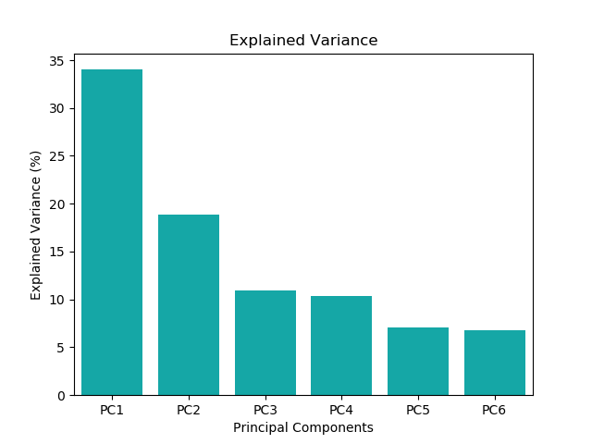
Measuring Team Performance
Principal Component Analysis (PCA) - a statistical technique for dimension reduction
We used “Per 100 possessions” stats to account for game pace
Positive factors include 3-pointers, free throws and assists. Negative components consist of missed shots, turnovers and fouls.

Slide 19
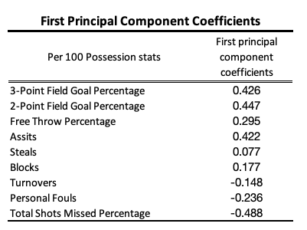
Using PC1 to Calculate Team Performance
Our model assigns the correct sign to positive and negative influences
Total shots missed, 2-point, 3-point field goals and assists have the highest explanatory power

Slide 20
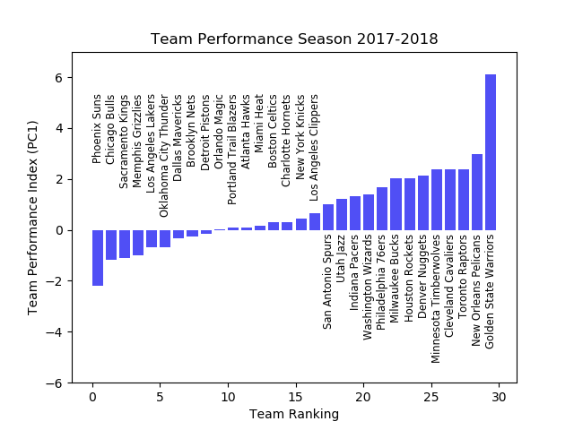
Team Performance: 2017-18 Season

Slide 21
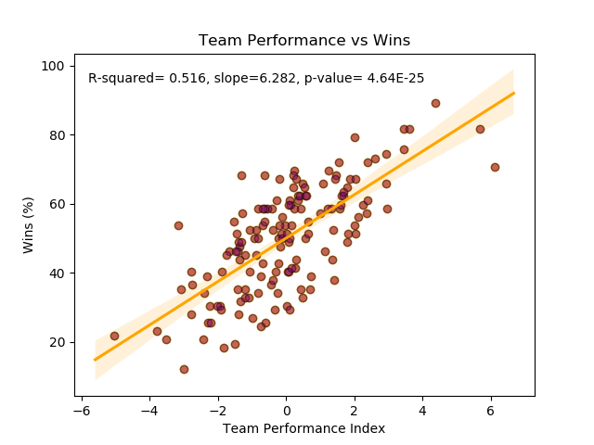
Team Statistics Capture Variance Better Than Individual Stats

Slide 22

Challenges
Challenges & Future Analysis
Merging data from different sources
Cleaning data (string manipulation)
Selecting pertinent factors for analysis
Time limitations
Future Analysis
What is the optimum number of superstars on a team? How well do teams that share the “rock” perform?
How much does coaching matter? Do teams with great coaches consistently outperform their player talent?
Do specific player combos have chemistry?
Diving into other advanced stats such as rebounding rate, assist to turnover ratio
Micro approach: study individual games and plays.
Notes:
Conclusion slide
Data sources
Cleaning data (team names)
Selecting factors for analysis

Slide 23
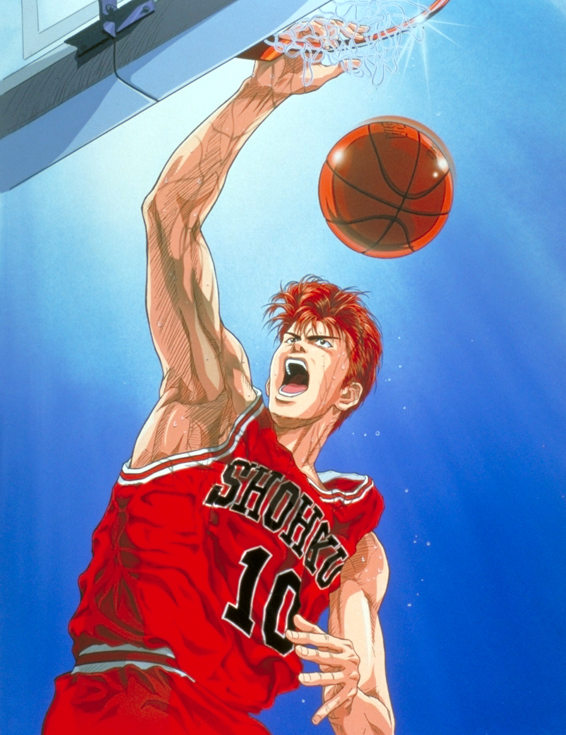
The End
If you are interested in our codes click here

